Slide 1
Smart Agriculture System based on IoT
Presented By: Vishakha Dakhane

Slide 2
What is IoT based Smart Farming?
The Internet of Things (IoT) describes the network of physical objects—“things”—that are embedded with sensors, software, and other technologies for the purpose of connecting and exchanging data with other devices and systems over the internet.
IoT based Smart Farming improves the entire Agriculture system by monitoring the field in real-time.
With the help of sensors and interconnectivity, the Internet of Things in Agriculture has not only saved the time of the farmers but has also reduced the extravagant use of resources such as Water and Electricity.

Slide 3
Why do we need it?
More data means better decisions.
Ability to track and monitor things.
Lighten the workload with automation.
Increases efficiency by saving money and resources.
Better quality of life.

Slide 4
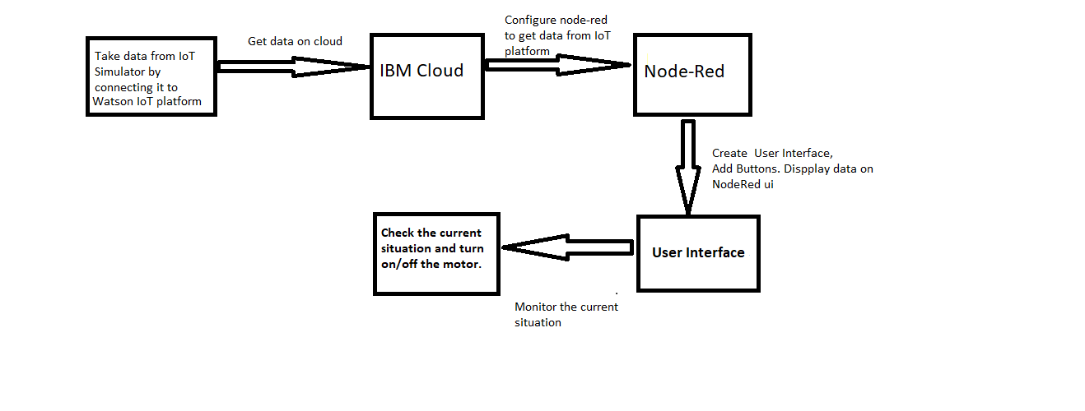
Block Diagram:

Slide 5
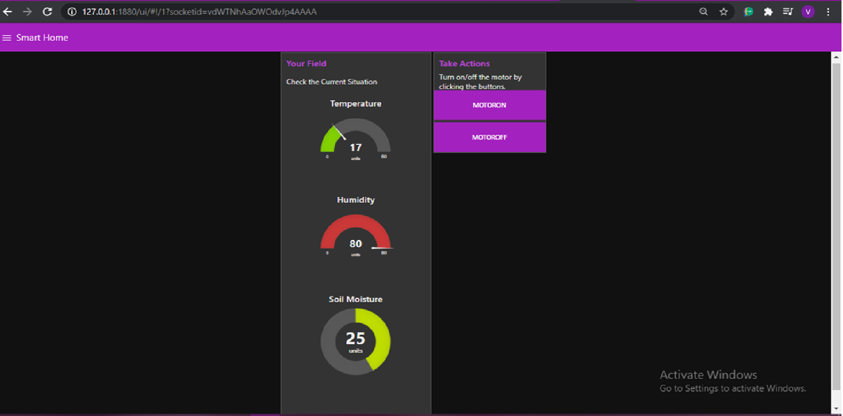
User Interface

Slide 6


